Slide 1
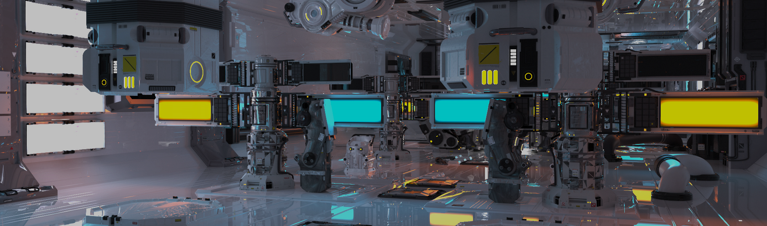
Programming
Computer Graphics Practice
Computer Graphics Lab | NTUST CSIE

Slide 2
Course Objectives
Boosting for those unfamiliar with application developing
Avoid common pitfalls when working on projects
Learn to solve problem with tools

Slide 3
Programming an application
Functionality
features
User Interface and I/O
console, script
GUI
Portability

Slide 4
Functionality
Writing codes to implement(which is surly done by yourself)
Integrate from third-party libraries

Slide 5
User Interface
Once you want to release your application, UI is a must for your program to provide interaction with users.
GUI, CLI, script
Usually, we use third-party library(tool) to design the GUI
Design GUI with GUI
e.g. Qt, windows form
Design GUI with script
e.g. FLTK(used by our template), imgui

Slide 6
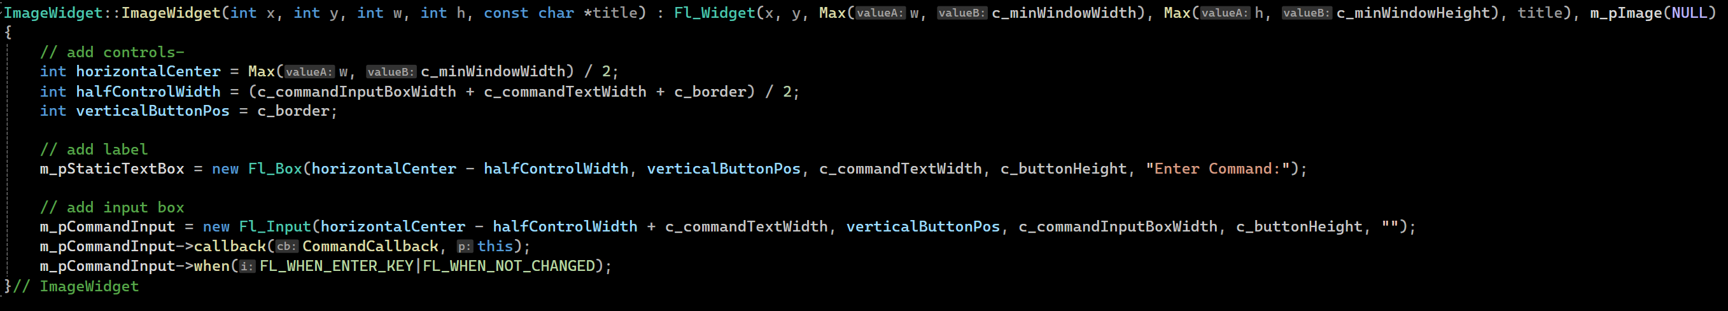
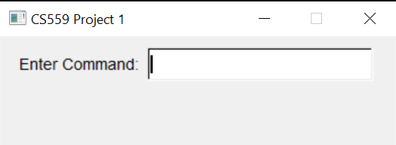
Design GUI with script
FLTK
Notes:
User Interface

Slide 7
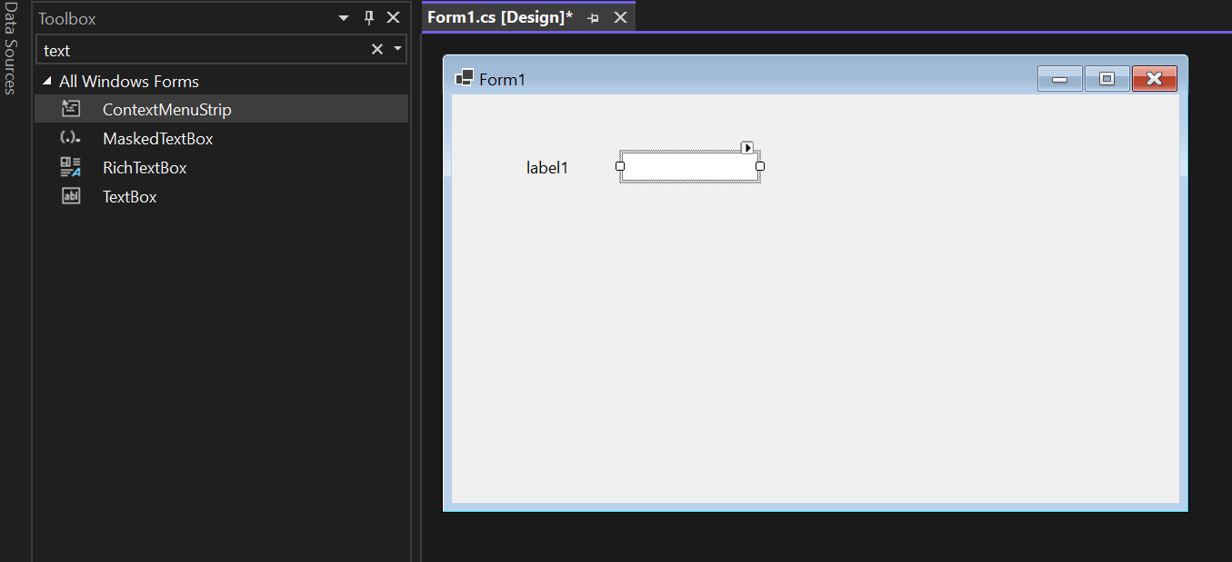
Design GUI with GUI
Windows form

Slide 8
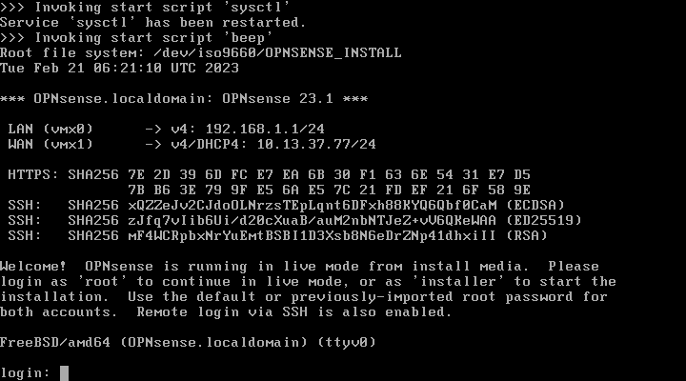
CLI
CLI from OPNsense

Slide 9
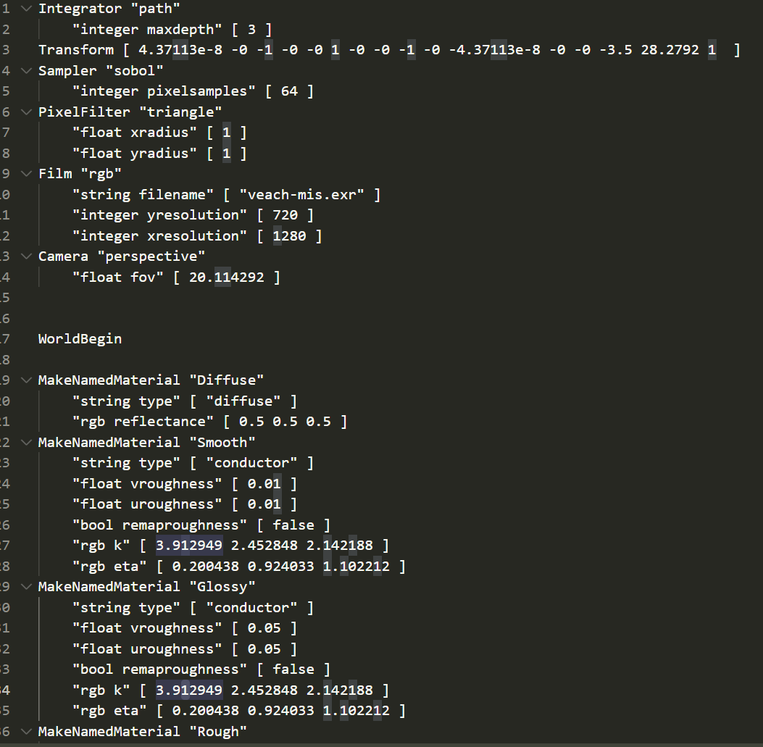
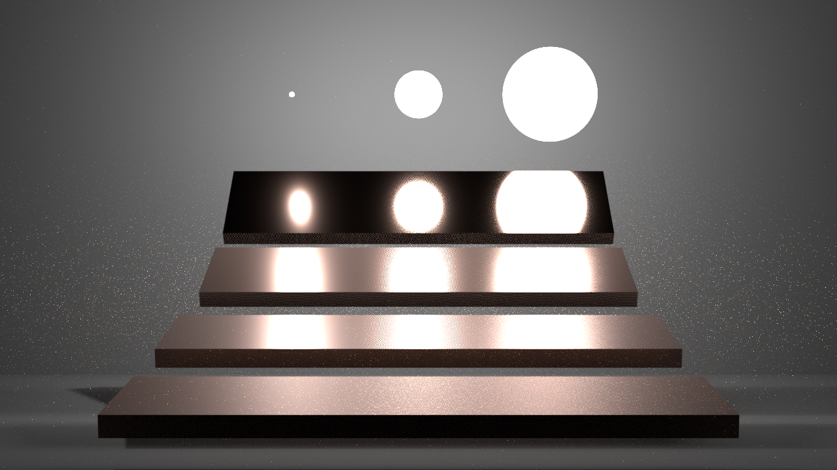
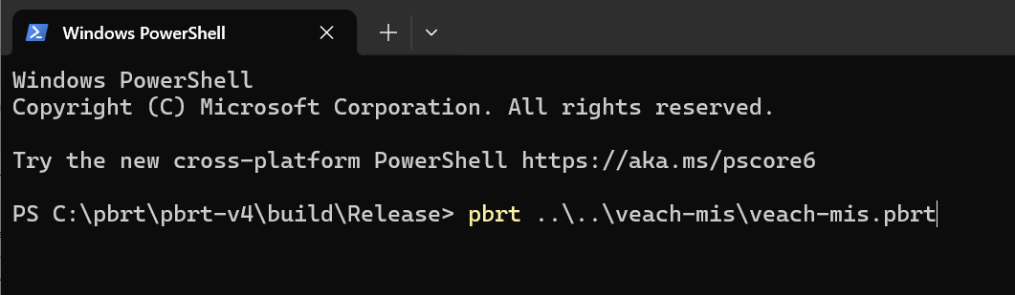
Script
This program(pbrt) renders a scene from the script
Script
Result
Prompt to use script(CLI or GUI)

Slide 10
Portability
Cross-platform
Mac, Linux, and Windows
Search path for resources
Runtime: Lib, DLL, and others that are required to run the program (shaders)
Compile-time: library, headers
Be careful with runtime resources if you want your program to be portable
Be careful with compile-time resources if you want your source code to be portable (i.e. build at other platform)

Slide 11
Why IDE
There are many to do while developing application
e.g. Coding, Compiling, and Debugging
Useful tool for these actions
e.g. Text editor, Building automation, and Memory debugger
These tools provide powerful features

Slide 12
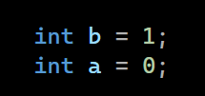

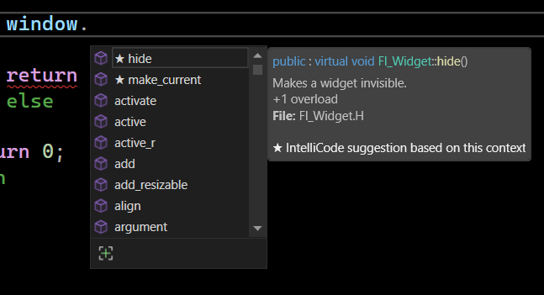
Text Editor
Powerful text manipulation
Swap line with alt in VS
Recommend or auto-complete

Slide 13
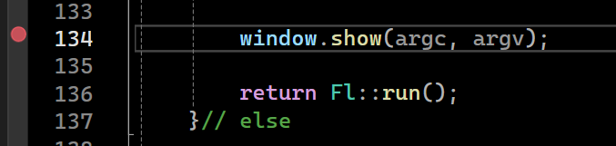
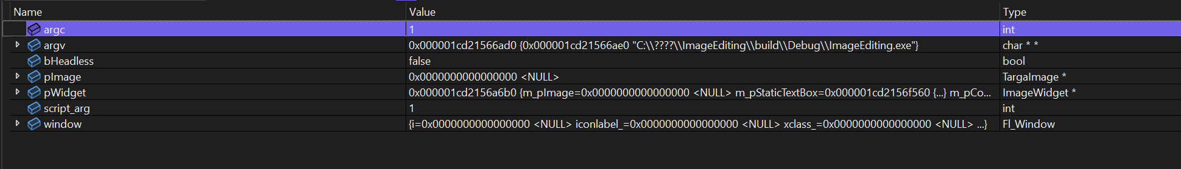
Memory Debugger
With program stopped at breakpoint, the memory debugger decodes and displays the variable status in memory in a gorgeous way.

Slide 14
Building Automation
When many files are involved in building a project, it can be complicated to maintain them individually
For example, compiling usually involves source files, headers, librarys, and DLLs
You might compile with commands like
Let the project handles this would be a good idea
g++ -o myprogram main.cpp utils.h -I./include -L./lib -lmylib -Wl,-rpath,./lib

Slide 15
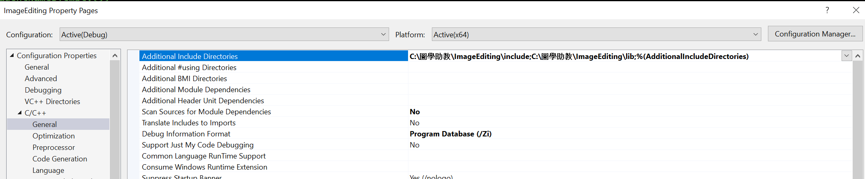
Building Automation
VS handles your setting in project, gathering required resources and communicate with compiler to finish the building

Slide 16
Recommend Environment
Environment used by our templates
Windows computer
Visual Studio 2019
Cmake

Slide 17
Visual Studio
Visual Studio is an integrated development environment (IDE) from Microsoft.
Built-in languages include C, C++, Visual Basic(VB), JavaScript ... etc.
The most basic edition of Visual Studio, the Community edition, is available free of charge.

Slide 18
Visual Studio Code
Visual Studio Code, also commonly referred to as VS Code, is a source-code editor made by Microsoft.
It can be used with a variety of programming languages, including C, C++, Visual Basic(VB), JavaScript, Node.js, Python, GLSL.
Feature includes syntax highlighting, bracket matching, code folding.

Slide 19
CMake
CMake is cross-platform software for build automation by using a compiler-independent method.
It supports directory hierarchies and applications that depend on multiple libraries.

Slide 20
CMake build project
Download Cmake
Download Project

Slide 21
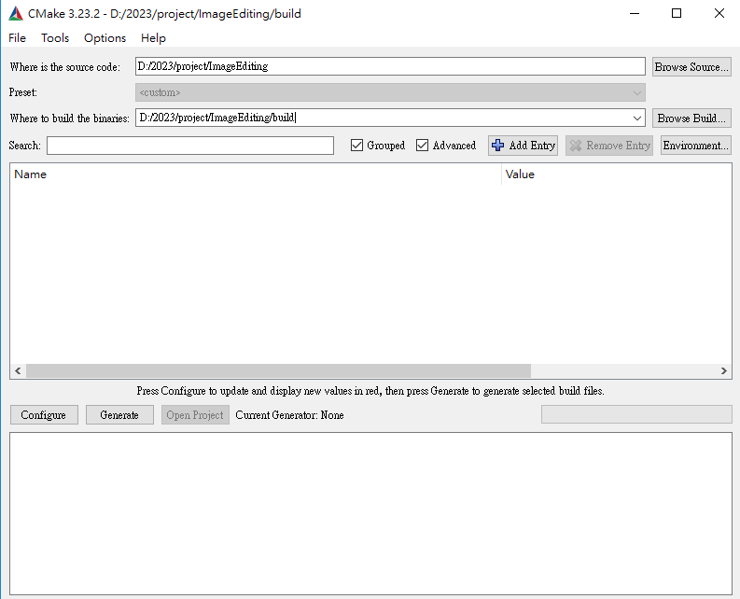
CMake build project
1.The project path with CMakeLists.txt
2.Project output path
3.Click Configure

Slide 22
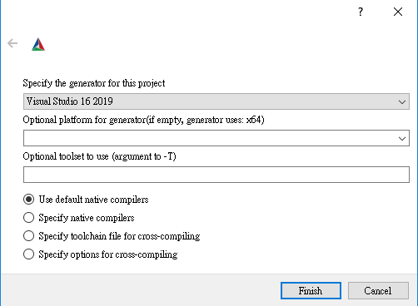
CMake build project
Select generator version

Slide 23
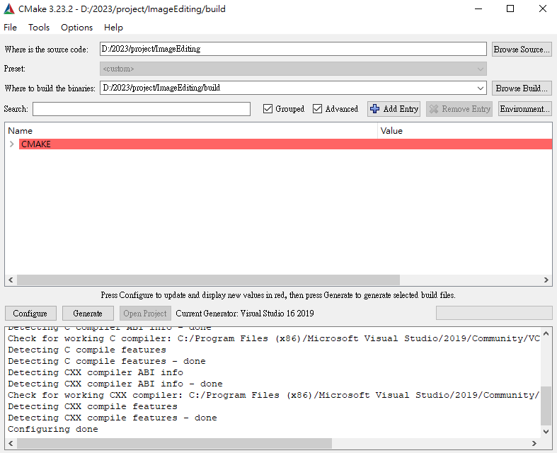
CMake build project
Wait Configuring Done

Slide 24
CMake build project
Generate Project

Slide 25
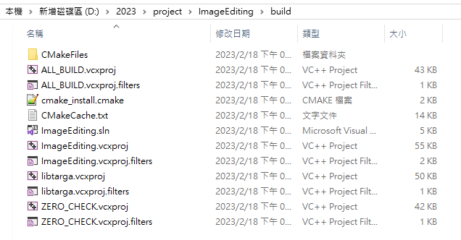
CMake build project
Generated Project file

Slide 26
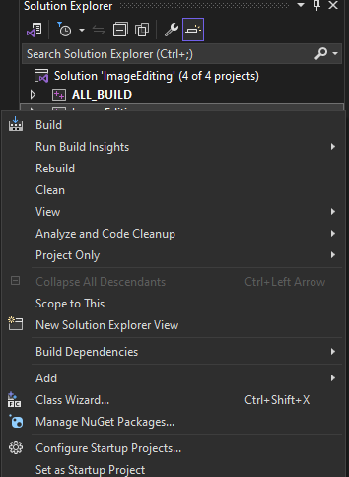
Build the sln project

Slide 27
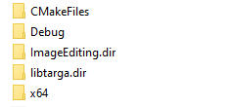
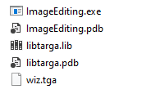
Execute the file

Slide 28
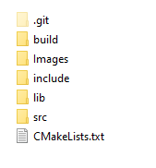
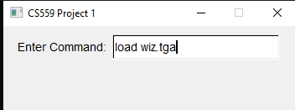

Open the tga pic

Slide 29
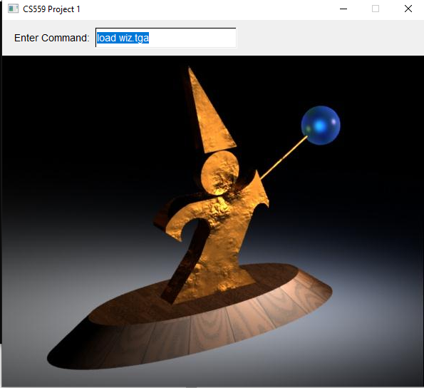
Result

Slide 30
Integrate Third-Party Library
In c++, there are three main ways to include third-party library
Source code provided library
A bunch of source files and headers, simply put somewhere like your code
Static loaded DLL library
Requires lib, dll, and header to load, include header and works like native code
Dynamic loaded DLL library
Requires dll only, you have to write your own header to load dll from pointer

Slide 31
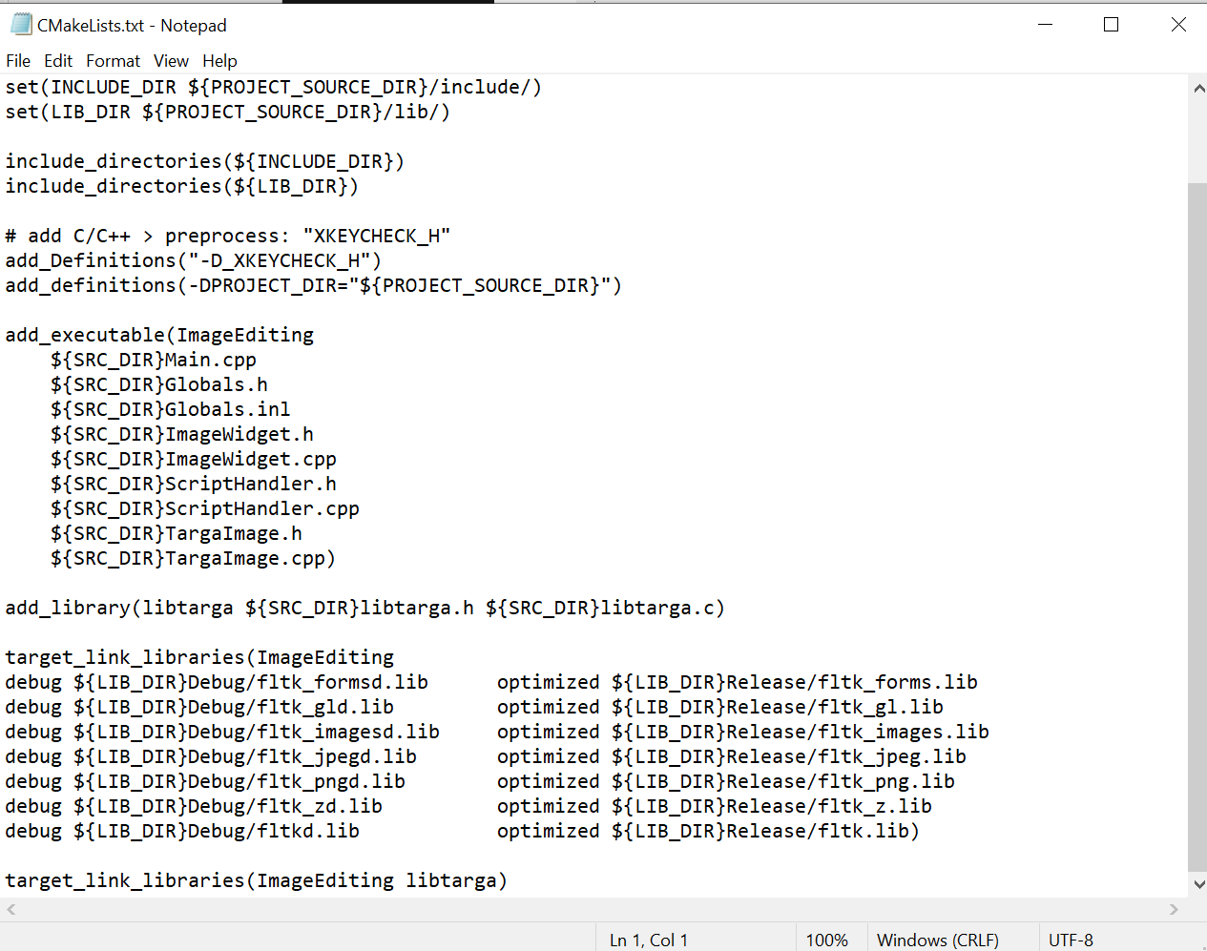
What’s next
You will need to integrate third-party libraries in the near future(e.g. OpenGL)
Learn through hands-on experience
It is always encouraged to ask for advice

Slide 32
Homework
Submission

